Slide 1

CUSTOM ANNOTATIONS

Slide 2

USE CASES
As passive documentation(there is no functionality in this case)
Instead of XML configuration
Reduce the effort of writing code, by providing us with default behaviour
Used as an alternative to marker interfaces to provide additional information about the object

Slide 3
Types of annotations
Marker annotation
Single valued
Multi valued
Meta annotation

Slide 4
Marker annotation
It does not have any elements (@Override @Depricated)
Its only purpose is to mark an item.
Example:
@interface MyAnnotation{}

Slide 5
Single and multi-valued
@interface MyAnnotation{
int value();
}
@interface MyAnnotation{
int value() default 0;
boolean isEven() default false;
}

Slide 6
Steps to create a custom annotation
Use the @interface keyword to define an annotation.
Define elements in it
Mention its scope and type
Additional customization if needed

Slide 7
@Target: Describes the targets to which an annotation can be applied (TYPE, CLASS, METHOD, FIELD etc.)
@Retention: Describes how long the annotation should be retained by the compiler (RUNTIME, SOURCE, CLASS)
@Inherited: Denotes that an annotation should be inherited by a subtype if applied to a supertype
@Deprecated: Denotes that an annotation (or any other type) should no longer be used
@Repeatable: Denotes that an annotation can be applied multiple times in the same context; i.e. a class can have the same annotation applied to it two or more times
@Documented: Marks the annotation for inclusion in the documentation.

Slide 8
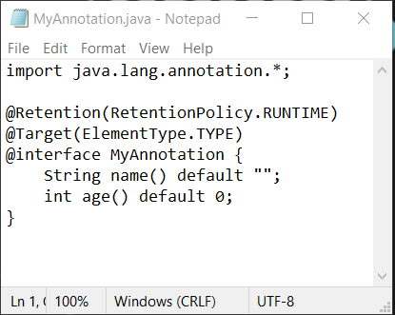
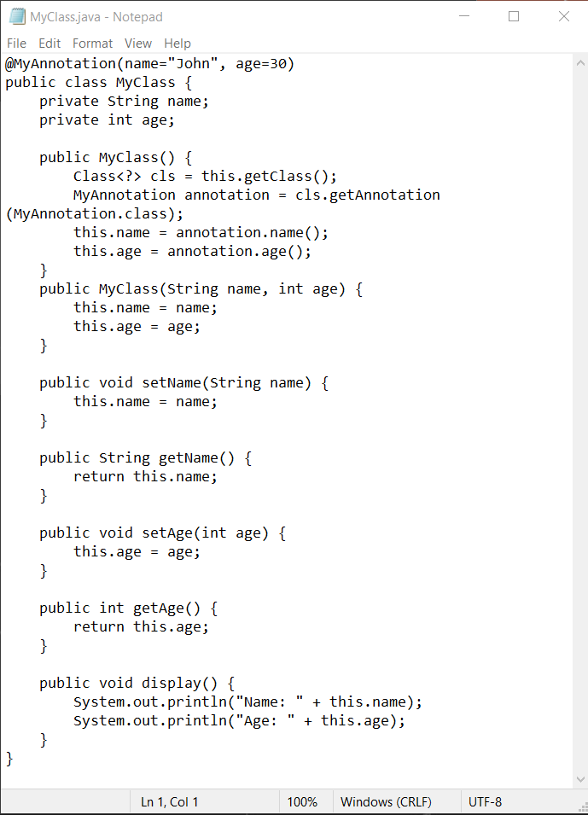
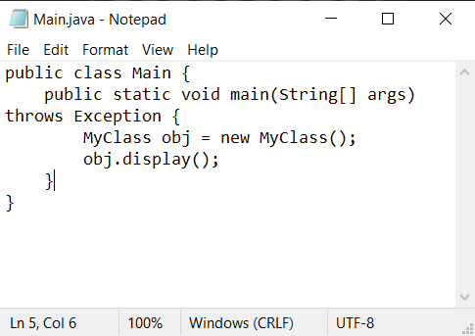

Slide 9
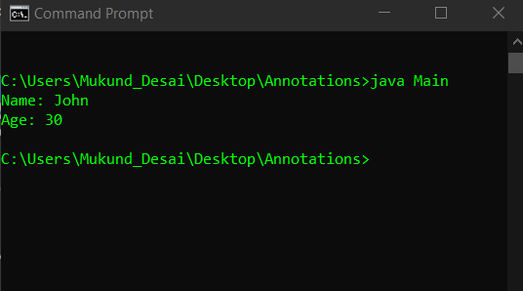

Slide 10

THANK YOU

